Slide 1
Numpy
Numerical Computing in Python
Shatha Zahi Melhem

Slide 2
Agenda
Numpy Overview.
Arrays.
Arrays, Basic Operations.
Transposition.
Saving and loading arrays.
Images array.
Mathmitical Operations.
Iteration over arrays.
Indexing
Slicing.
Axis
Library of Links

Slide 3
What is Numpy?
Stands for Numerical Python
Open-source library for:
Working with arrays
Performing mathematical operations
Efficient numerical computations
Widely used in data science and machine learning
Numpy Features:
Typed multidimentional arrays (matrices)
Fast numerical computations (matrix math)
High-level math functions

Slide 4
Why do we need NumPy
Let’s see for ourselves!

Slide 5
Why do we need NumPy
Python does numerical computations slowly.
1000 x 1000 matrix multiply
Python triple loop takes > 10 min.
Numpy takes ~0.03 seconds

Slide 6
NumPy Overview
Arrays
Shaping and transposition
Mathematical Operations
Indexing and slicing

Slide 7
Arrays
Structured lists of numbers.
Vectors
Matrices
Images
Tensors
ConvNets

Slide 8

Arrays
Structured lists of numbers.
Vectors
Matrices
Images
Tensors
ConvNets
$$\left[\begin{matrix}p_{x} \\ p_{y} \\ p_{z}\end{matrix}\right]$$
$$\left[\begin{matrix}a_{11} & ⋯ & a_{1n} \\ ⋮ & ⋱ & ⋮ \\ a_{m1} & ⋯ & a_{mn}\end{matrix}\right]$$

Slide 9

Arrays
Structured lists of numbers.
Vectors
Matrices
Images
Tensors
ConvNets

Slide 10
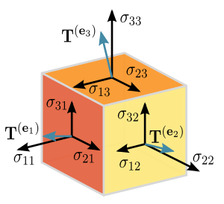
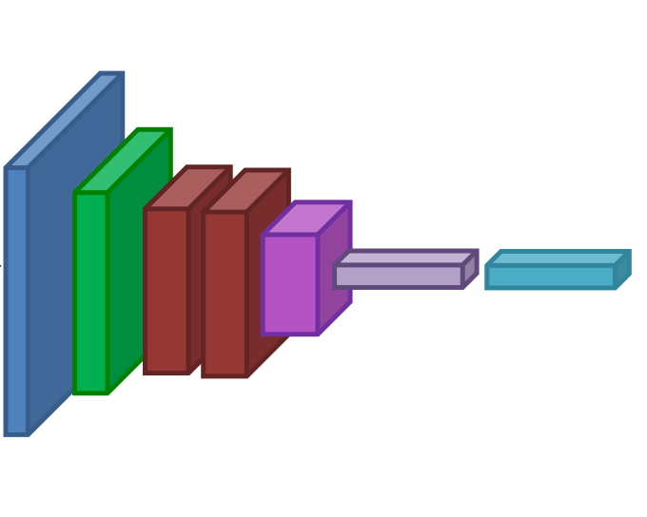
Arrays
Structured lists of numbers.
Vectors
Matrices
Images
Tensors
ConvNets

Slide 11
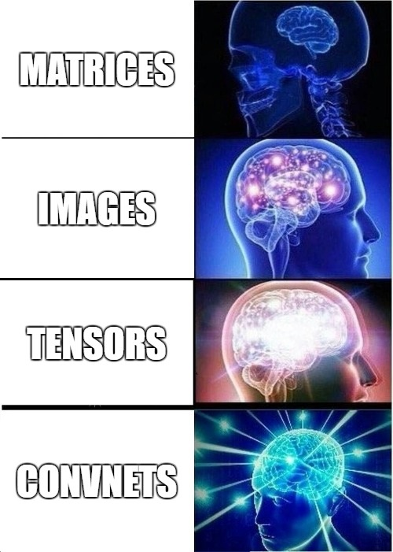
Arrays
Structured lists of numbers.
Vectors
Matrices
Images
Tensors
ConvNets

Slide 12
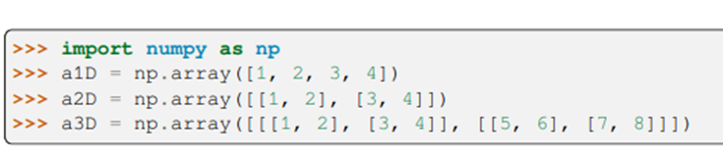
Arrays, Basic Properties
import numpy as np
a = np.array([[1,2,3],[4,5,6]],dtype=np.float32)
print a.ndim, a.shape, a.dtype
Arrays can have any number of dimensions, including zero (a scalar).
Arrays are typed: np.uint8, np.int64, np.float32, np.float64
Arrays are dense. Each element of the array exists and has the same type.

Slide 13
Arrays, creation
np.ones, np.zeros
np.arange
np.concatenate
np.astype
np.zeros_like, np.ones_like
np.random.random

Slide 14
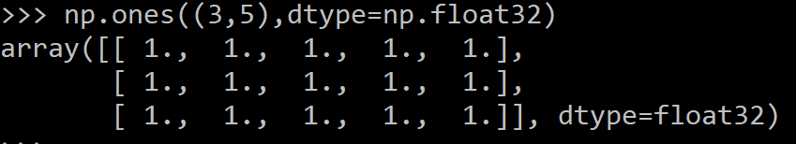
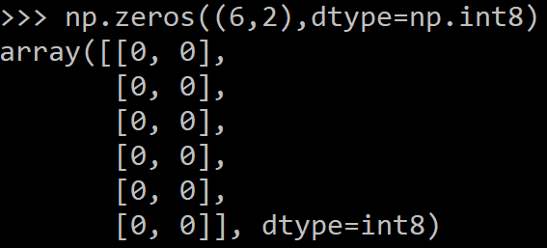
Arrays, creation
np.ones, np.zeros
np.arange
np.concatenate
np.astype
np.zeros_like, np.ones_like
np.random.random

Slide 15

Arrays, creation
np.ones, np.zeros
np.arange
np.concatenate
np.astype
np.zeros_like, np.ones_like
np.random.random

Slide 16
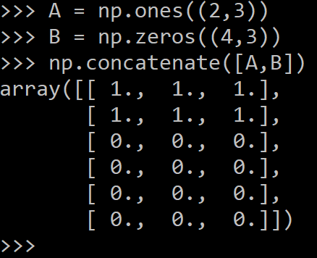
Arrays, creation
np.ones, np.zeros
np.arange
np.concatenate
np.astype
np.zeros_like, np.ones_like
np.random.random

Slide 17
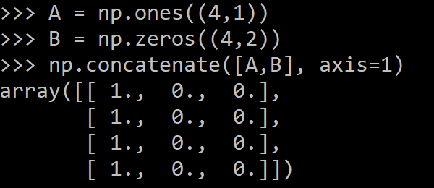
Arrays, creation
np.ones, np.zeros
np.arange
np.concatenate
np.astype
np.zeros_like, np.ones_like
np.random.random

Slide 18
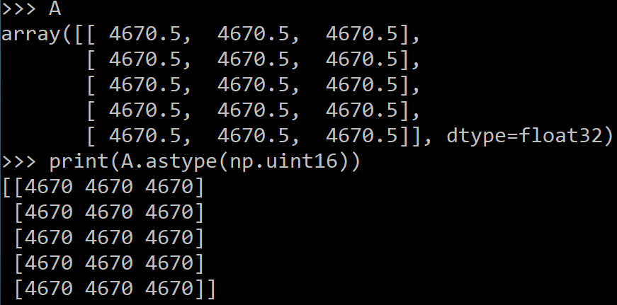
Arrays, creation
np.ones, np.zeros
np.arange
np.concatenate
np.astype
np.zeros_like, np.ones_like
np.random.random

Slide 19
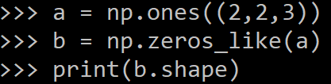
Arrays, creation
np.ones, np.zeros
np.arange
np.concatenate
np.astype
np.zeros_like, np.ones_like
np.random.random

Slide 20
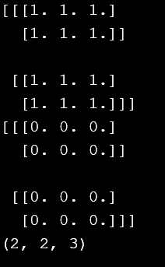

Slide 21
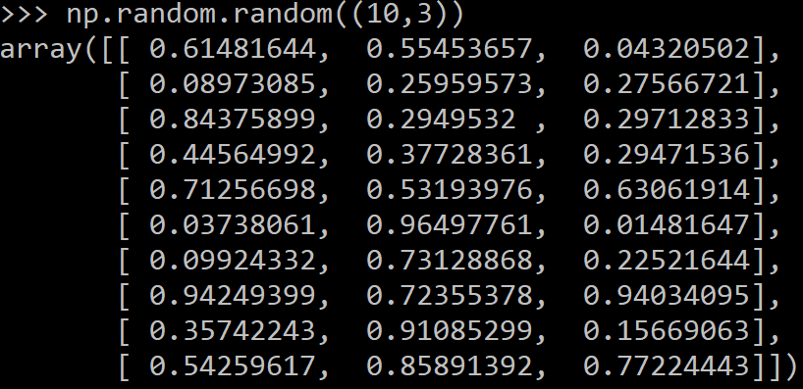
Arrays, creation
np.ones, np.zeros
np.arange
np.concatenate
np.astype
np.zeros_like, np.ones_like
np.random.random

Slide 22
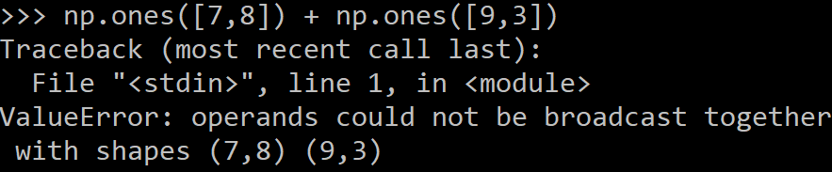
Arrays, danger zone
Must be dense, no holes.
Must be one type
Cannot combine arrays of different shape

Slide 23
Changing the shape of an array
a = np.array([1,2,3,4,5,6])
a = a.reshape(3,2)
a = a.reshape(2,-1)
a = a.ravel()
Total number of elements cannot change.
Use -1 to infer axis shape
Row-major by default (MATLAB is column-major)

Slide 24
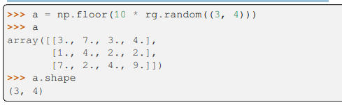
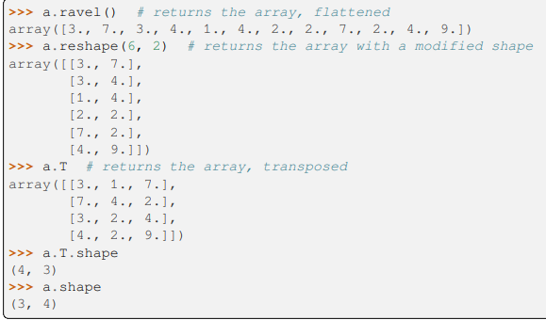
Example: An array has a shape given by the number of elements along each axis:
The shape of an array can be changed with various commands. Note that the following three commands all return a modified array, but do not change the original array:

Slide 25
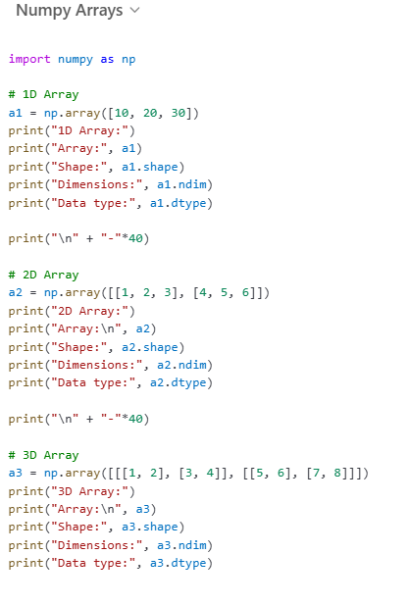
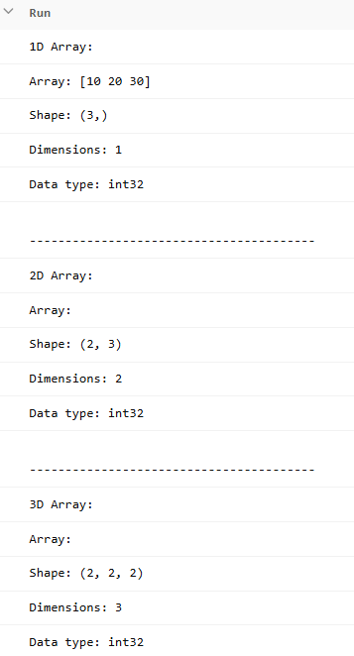
Extra Example

Slide 26
Return values
Numpy functions return either views or copies.
Views share data with the original array, like references in Java/C++. Altering entries of a view, changes the same entries in the original.
View: It is possible to access the array differently by just changing certain metadata like stride and dtype without changing the data buffer. This creates a new way of looking at the data and these new arrays are called views. The data buffer remains the same, so any changes made to a view reflects in the original copy.
Copy: When a new array is created by duplicating the data buffer as well as the metadata, it is called a copy. Changes made to the copy do not reflect on the original array. Making a copy is slower and memory-consuming but sometimes necessary.
Np.copy, np.view make explicit copies and views.

Slide 27
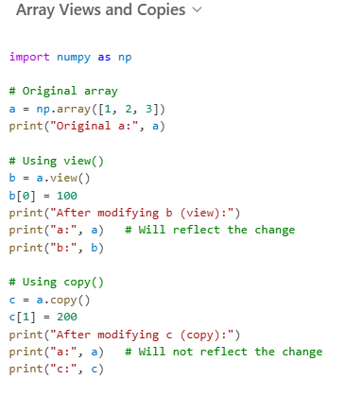
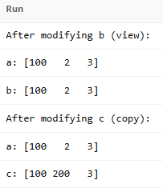

Slide 28
Transposition
a = np.arange(10).reshape(5,2)
a = a.T
a = a.transpose((1,0))
np.transpose permutes axes.
a.T transposes the first two axes.

Slide 29
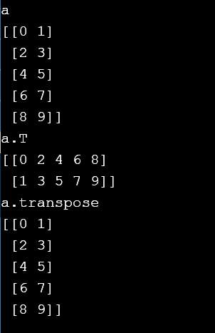

Slide 30
Saving and loading arrays
np.savez(‘data.npz’, arr=a)#Now the file data.npz contains -arr- array
data = np.load(‘data.npz’)
a = data[‘arr’] )#Access stored array –arr-
NPZ files can hold multiple arrays
np.savez_compressed similar, but compresses the file to reduce size.
The variable name used to retrieve it later

Slide 31
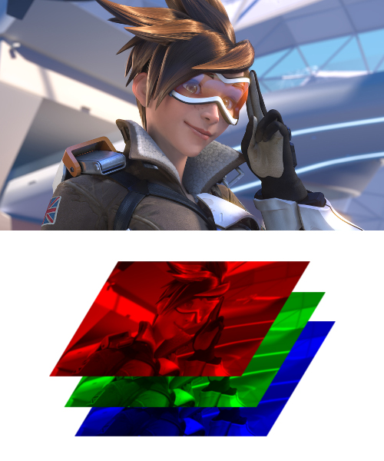
Image arrays
Images are 3D arrays: width, height, and channels
Common image formats:
height x width x RGB (band-interleaved)
height x width (band-sequential)
Gotchas:
Channels may also be BGR (OpenCV does this)
May be [width x height], not [height x width]

Slide 32
RGB stands for Red Green Blue.
Most often, an RGB color is stored in a structure or unsigned integer with Blue occupying the least significant “area” (a byte in 32-bit and 24-bit formats), Green the second least, and Red the third least.
BGR is the same, except the order of areas is reversed.

Slide 33
Saving and Loading Images
SciPy: skimage.io.imread,skimage.io.imsave
height x width x RGB
PIL / Pillow: PIL.Image.open, Image.save
width x height x RGB
OpenCV: cv2.imread, cv2.imwrite
height x width x BGR

Slide 34
Recap
We just saw how to create arrays, reshape them, and permute axes

Slide 35
Recap
We just saw how to create arrays, reshape them, and permute axes
Now: let’s do some math

Slide 36
Mathematical operators
Arithmetic operations are element-wise
Logical operator return a bool array
In place operations modify the array

Slide 37
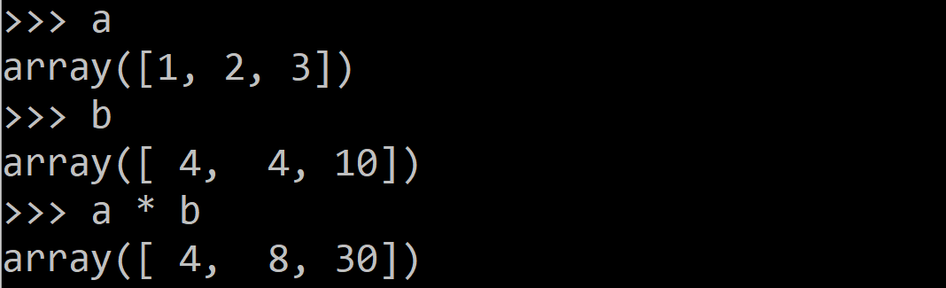
Mathematical operators
Arithmetic operations are element-wise
Logical operator return a bool array
In place operations modify the array

Slide 38
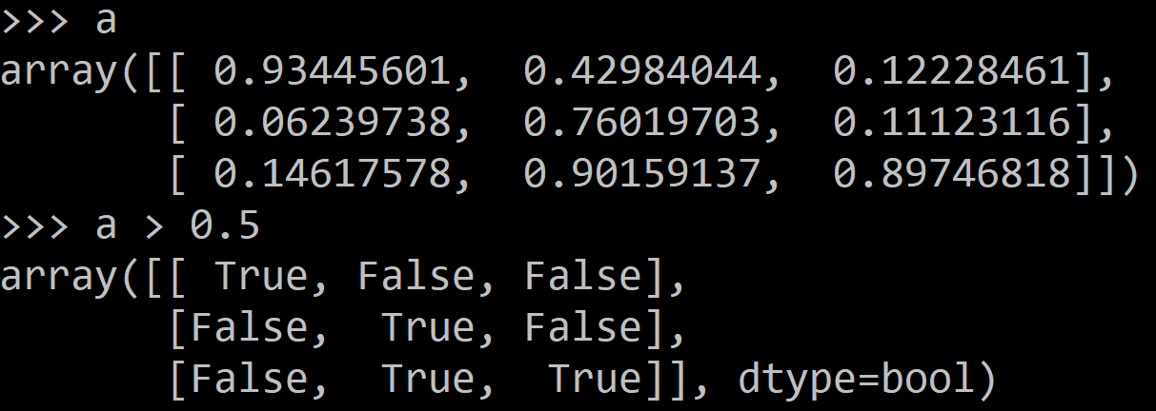
Mathematical operators
Arithmetic operations are element-wise
Logical operator return a bool array
In place operations modify the array

Slide 39
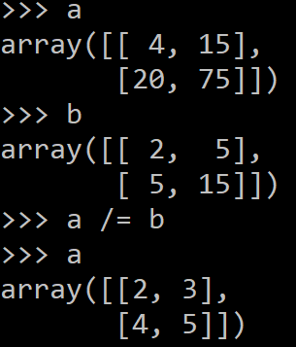
Mathematical operators
Arithmetic operations are element-wise
Logical operator return a bool array
In place operations modify the array

Slide 40
Math, upcasting
Just as in Python and Java, the result of a math operator is cast to the more general or precise datatype.
uint64 + uint16 => uint64
float32 / int32 => float32
Warning: upcasting does not prevent overflow/underflow. You must manually cast first.
Use case: images often stored as uint8. You should convert to float32 or float64 before doing math.

Slide 41
Math, universal functions
Also called ufuncs
Element-wise
Examples:
np.exp
np.sqrt
np.sin
np.cos
np.isnan

Slide 42

Math, universal functions
Also called ufuncs
Element-wise
Examples:
np.exp
np.sqrt
np.sin
np.cos
np.isnan

Slide 43
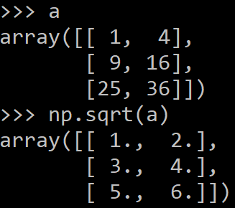
Math, universal functions
Also called ufuncs
Element-wise
Examples:
np.exp
np.sqrt
np.sin
np.cos
np.isnan

Slide 44
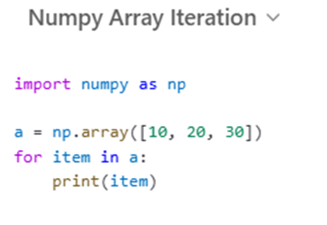

Iteration over arrays
Iteration over 1Darray,2D array

Slide 45


Iteration over arrays
Iteration over 1Darray,2D array

Slide 46
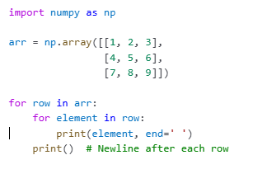
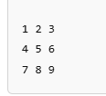
Iteration over arrays
Iteration over 1Darray,2D array

Slide 47
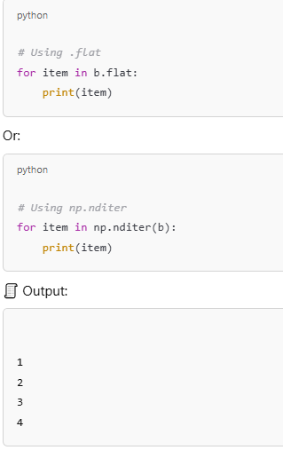
Iteration over arrays
Iteration over 1Darray,2D array
Use .flat or np.nditer for element-by-element iteration:

Slide 48
Indexing
x[0,0] # top-left element
x[0,-1] # first row, last column
x[0,:] # first row (many entries)
x[:,0] # first column (many entries)
Notes:
Zero-indexing
Multi-dimensional indices are comma-separated (i.e., a tuple)

Slide 49
Indexing, slices and arrays
I[1:-1,1:-1] # select all but one-pixel border
I = I[:,:,::-1] # swap channel order
I[I<10] = 0 # set dark pixels to black
I[[1,3], :] # select 2nd and 4th row
Slices are views. Writing to a slice overwrites the original array.
Can also index by a list or boolean array.

Slide 50
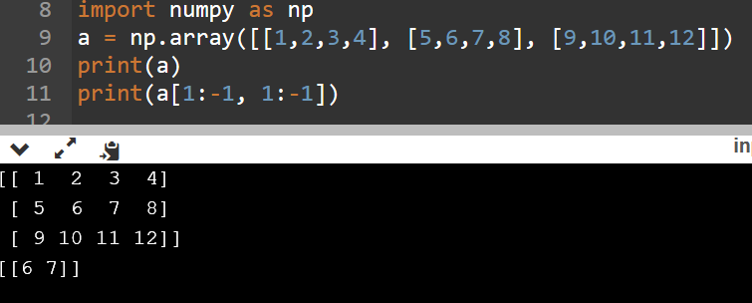

Slide 51
Python Slicing
Syntax: start:stop:step
a = list(range(10))
a[:3] # indices 0, 1, 2
a[-3:] # indices 7, 8, 9
a[3:8:2] # indices 3, 5, 7
a[4:1:-1] # indices 4, 3, 2 (this one is tricky)

Slide 52
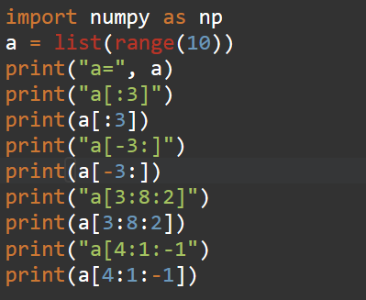
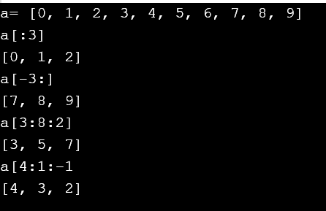

Slide 53
Axes
a.sum() # sum all entries
a.sum(axis=0) # sum over rows
a.sum(axis=1) # sum over columns
a.sum(axis=1, keepdims=True)
Use the axis parameter to control which axis NumPy operates on
Typically, the axis specified will disappear, keepdims keeps all dimensions

Slide 54
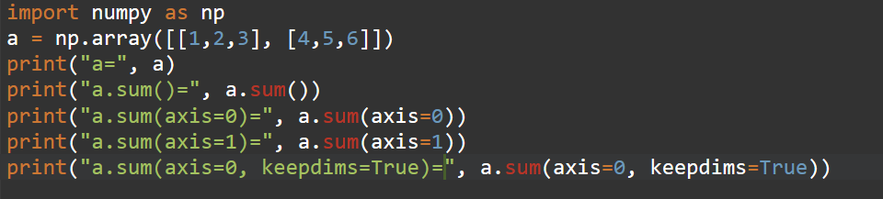
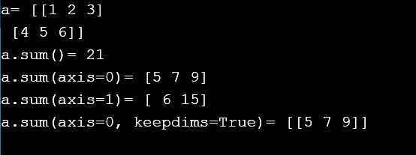

Slide 55
Library of Links for Further Reading & Practicing
http://numpy.org/
https://numpy.org/doc/stable
https://www.w3resource.com/python-exercises/numpy/index.php
https://www.kaggle.com/learn/numpy
https://colab.research.google.com/github/kevinzakka/numpy-ml/blob/master/numpy-ml.ipynb

